Slide 1
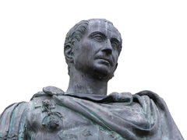
Julius Caesar
By: William Shakespeare

Slide 2
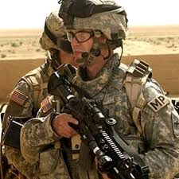
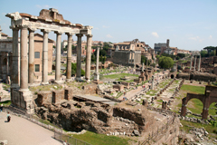
Intro
The setting of this place is Ancient Rome.
Shakespeare creates a world full of:
political intrigue
magical occurrences
military conquest.

Slide 3
Intro
Caesar, the most powerful man in Rome, has recently returned to the city after months of fighting abroad.
Caesar was fighting Pompey, another powerful Roman, and his sons.
Pompey, as well as others in the Roman senate, was disturbed by Caesar’s growing ambition.
“Haters”

Slide 4
Intro
Their fears seem to be valid when Caesar refuses to enter Rome as an ordinary citizen after the war.
Instead, he marches his army on Rome and takes over the government.
But… the people don’t mind…

Slide 5
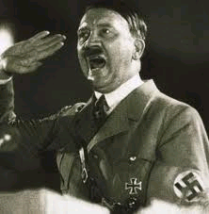
Intro
Caesar is made dictator, or ruler—a position that was sometimes granted for a ten-year term—for the rest of his life.
Many senators, however, resent Caesar for having so much power.

Slide 6
Senators
Brutus, Caesar’s friend who believes that he must act against Caesar for the good of Rome Casca, who hates the ordinary citizens of Rome yet is jealous because they love Caesar and not him Cassius, a greedy and jealous man who wants to take drastic measures to keep Caesar from winning any more power—and to take away any power that Caesar previously had

Slide 7
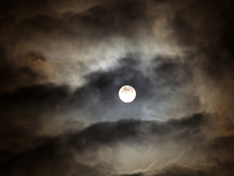
Superstition
Shakespeare uses Roman customs and superstition to create spooky conditions to mirror the dangerous plot being planned.

Slide 8
Omens
The Romans believed that omens could reveal the future.
These omens could take the form of unusual weather, flights of birds, or other natural phenomena.

Slide 9
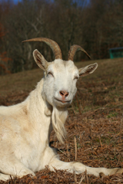
Predictions
The Soothsayer – makes predictions throughout the play
Animals were seen as indicators of the future.
The Romans often sacrificed animals to the gods, and had their entrails (guts) examined by an official called a haruspex. Any abnormalities or imperfections indicated the anger of a god or a particularly bad event about to happen.

Slide 10
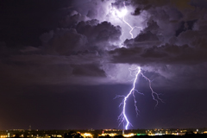
Predictions
Unusual astronomical and meteorological occurrences were also seen as signs of future events.
Solar eclipses were believed to foreshadow doom, as was lightning.

Slide 11
History
Around 509 B.C., the Romans ended a monarchy by rebelling against the last king of Rome, Tarquinius.
After this revolution, the Romans established their famous republic, in which all citizens were represented in the Senate.
They were very proud of their non-king ruled government, and were determined to preserve it—but when Caesar arrived, they changed their minds!

Slide 12
Caesar Themes
Fate vs. Free Will
Public Self vs. Private Self
Inflexibility vs. Compromise
Misinterpretations
Misreadings
Rhetoric
Power
Ambition
Betrayal
Friendship
Manipulation
Pride
Politics

Slide 13
Discussion
How important is loyalty?
Does your country or do your friends consider “loyalty” something to value? When can “loyalty” sometimes cause problems?
What should people do when loyalty to their country and loyalty to their friend comes into conflict?
Are there limits to what people should do in defense of the nation?

